Slide 1

Welcome to Travis High School

Slide 2
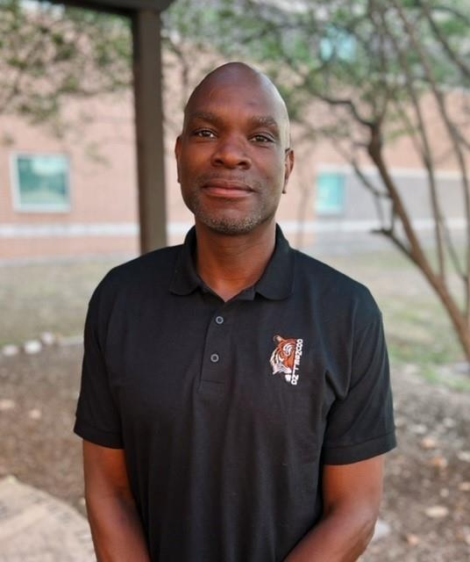
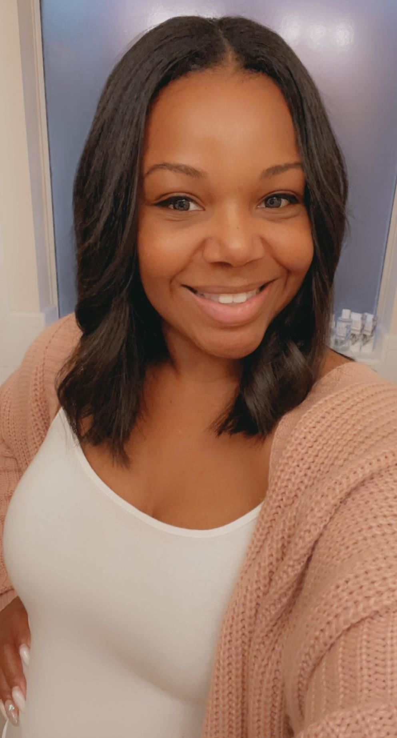
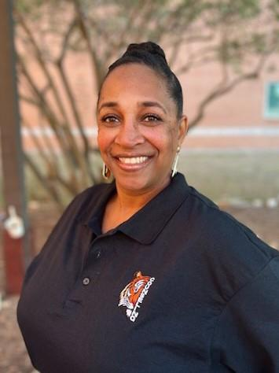
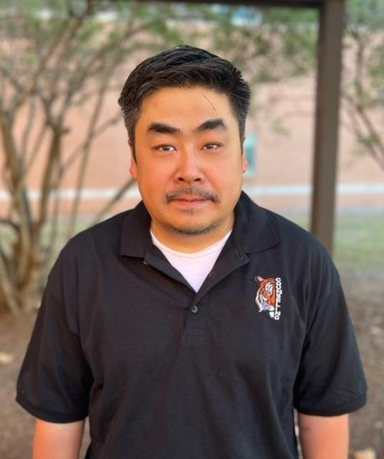
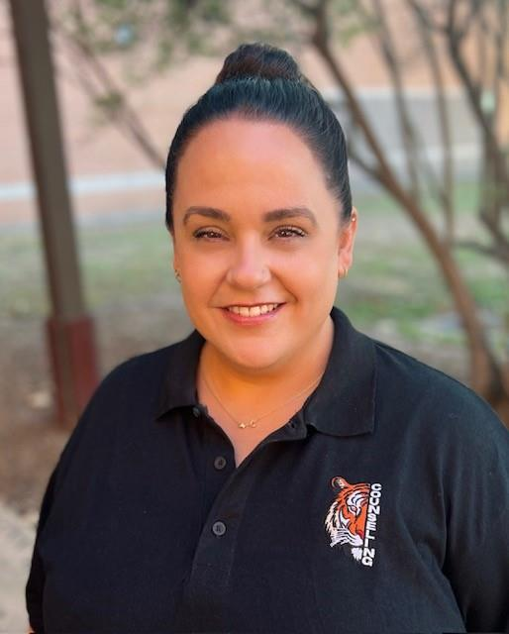
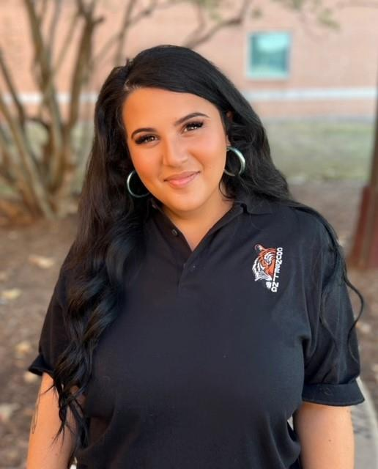
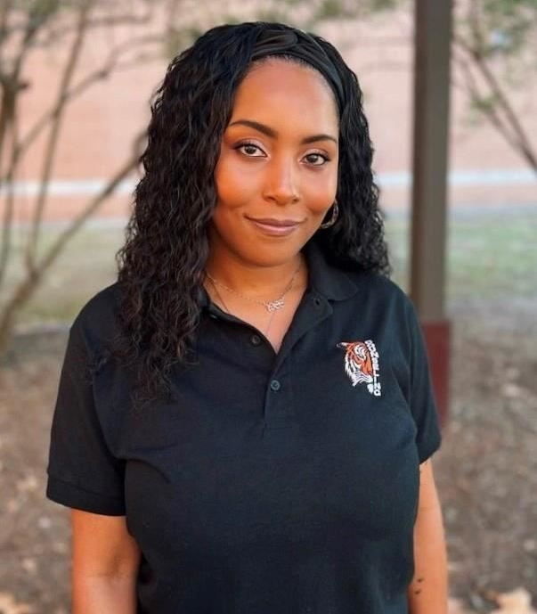
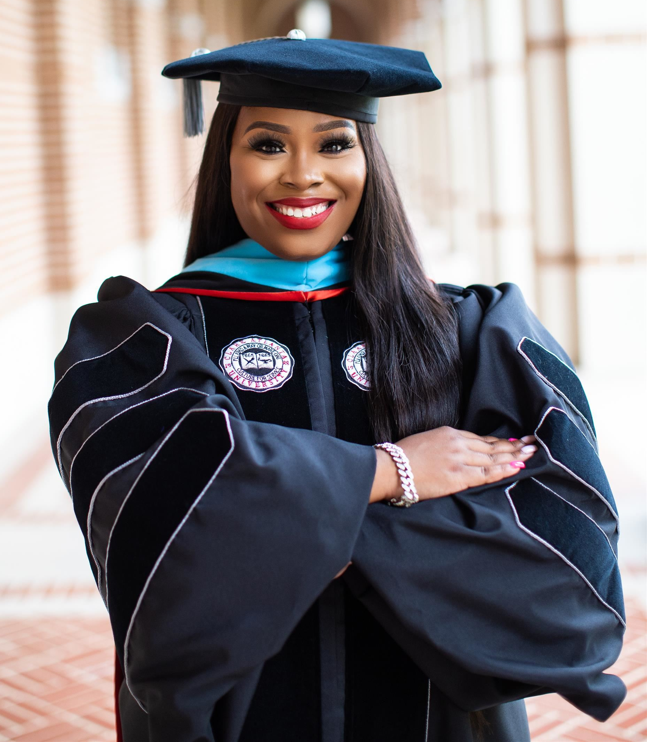
Travis Counselors
Mr. McCray: Bo-Do
Ms. Sims: Dr-Hen
Ms. Thomas: A-Blu
Mr. Chiu: Poo-Ste
Ms. Clark: Ki-Mor
Ms. Stephenson: Sto-Z
Ms. Westmoreland: Her-Kh (Lead Counselor)
Dr. King: Mos-Pol
Notes:
Before we get started, I want to introduce you to the counseling team at Travis High School. We are all excited that you will be coming, and we are ready to help you have a successful high school career.

Slide 3
How to Contact your Counselor
Go to the Travis High School website
Under Parents and Students, click Counseling
Click Request to see your Counselor, click on your Alpha Split counselor
Notes:
If you need to see your Counselor for any reason, please follow these steps. Please remember, that if you need immediate attention from your counselor in an emergency, you can ask your teacher for a pass to the counseling office. As a note, schedule concerns are not emergencies!

Slide 4
What do Counselors Do??
Counselors are MUCH more than schedule changers!!
Individual Planning
Course Selection- ensuring you remain on track to graduate on time
Post Secondary Information- Scholarships, letters of recommendation
Career Decisions- Pathways and Endorsements
Grade Level Visits- one on one and in classrooms
Notes:
Counselors here at Travis do so much more than just change schedules. Our counseling program is organized into four different components, and we build our activities and services around these. The first is individual planning, which includes counseling activities to assist all students to plan, monitor, and manage their own academic achievement as well as their personal and career development.

Slide 5
What Counselors Do…
System Support
Working with teachers, administrators, and parents to ensure student success
Responsive Services
Social and Emotional Learning
Crisis Intervention
Guidance Curriculum
Wellness Wednesday
Character Development
Monthly Newsletters
SEL Groups
Notes:
The second is system support, which includes any indirect guidance activities that maintain and enhance the total guidance program, like working closely with teachers, administrators and parents. The third component is responsive services, includes counseling or referral activities to meet the immediate needs and concerns of students. Responsive services includes personal counseling; crisis counseling; agency referral; consultation with parents, teachers, and other professionals, support groups; and problem solving. And the last component of our program is guidance curriculum. Guidance curriculum includes structured experiences presented systematically through classroom and group activities for all grades. The purpose is awareness and skill development.

Slide 6
Classification of Students
Grade Level for students 9-12 grade is determined by the number of credits earned
Freshmen 0-5 credits
Sophomore 6 credits
Junior 12 credits
Senior 18 credits
Notes:
To be classified as a 10th, 11th or 12th grader, you must earn a minimum amount of course credit each year. This does include summer school credit and online courses. In August of each year, your classification is determined for the school year. If you’ve earned the number of credits shown, you get that classification. If not, you must wait until the next year. Seniors are the exception to this rule.

Slide 7
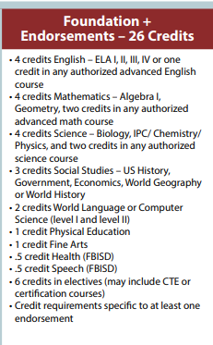
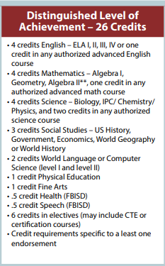

Graduation Plans
A total of 26 specific credits are needed to graduate
Notes:
You will graduate on the Foundation + Endorsements plan or on the Distinguished Level of Achievement plan. On the foundation plan, you must take Algebra I & Geometry, but you get to choose the other two advanced math courses. On the distinguished plan, Algebra I, Geometry & Algebra II are required. You get to pick the 4th math course. Now let’s look at science. Both plans have the same requirements. Now look at Social Studies. Both plans require U.S. History, Government/Economics, but you can choose to take W. Geography, W. History or both. We do suggest that you take both as most 4 year universities do look for that. No matter which plan you pursue, you must complete 2 credits of the same foreign language, Speech and Health, PE and a Fine Art. You can see the other credit requirement of 6 electives will total 26. Because you take 7 classes per year, for four years, many of you will graduate with more than 26 credits. Not to mention your high school courses taken in middle school as well as summer school. I’ve seen some students graduate with more than 30 credits!!

Slide 8
EOC (STAAR) Test Requirements
There are five EOC tests that are required for graduation:
Algebra 1
Biology
English 1
English 2
US History
Notes:
You are required to pass all five EOC tests in order to graduate. As a note, passing your STAAR exam is not tied to your classification.

Slide 9

What is an Endorsement?
An Endorsement is a related series of courses that are grouped together by interest or skill set. They provide you with in-depth knowledge of a subject area.
Notes:
In addition to you passing all your EOC exams and credit requirements, you must now also earn at least one endorsement to graduate. One important note, your endorsement classes are not taken in addition to your 26 credit requirement, they are actually built within. Your endorsement pathway is completed through those 6 elective credits. Some of your core classes could also earn you an endorsement. Let's first refresh your memory on what an endorsement is. Endorsements consist of a related series of courses that are grouped together by interest or skill set. They provide students with in-depth knowledge of a subject area.
. You may be wondering, how do endorsements help me, especially when applying to college. Well, an endorsement shows college admissions office that you were committed to and completed a series of courses. This can show them that you will be as committed when completing your college major. And if you choose a major similar to your high school endorsement, you may walk into your college classes with more knowledge about that subject than others.

Slide 10
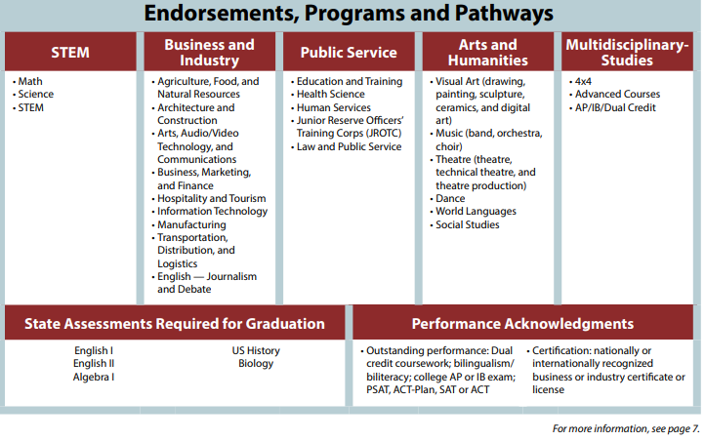
Notes:
You have 5 endorsement options with multiple pathways: READ THE ENDORSEMENTS.

Slide 11
Gifted and Talented
If you are GT identified, you must enroll in advanced courses (AAC, AP, Dual Credit)
in your areas of GT strength.
GT areas of strength:
•Math and Science
•English and Social Studies
•All four areas
If you are unsure of your area of strength, reach out to our GT Counselor, Ms. Sims.

Slide 12
Schedule Verification and Corrections
Course Selection Window: 1/26/2026-2/13/2026-
Students input Course Selection in School Links
Verification Window: 3/9/2026-3/13/2026-
Students and parents review Course Selection and make changes if necessary.
The verification period is the last time
students will be able to make changes
to course selections.
After the verification period, Counselors will only make schedule corrections for the following reasons:
•You are in a class you already have credit for
•You are missing a period
•You are missing a class that is required for graduation

Slide 13
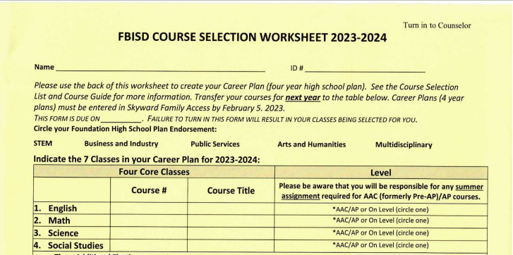
Course Selection Form-Endorsement and Core Courses
Neatly print your name and ID #
Circle your chosen endorsement plan
Select your Core Courses:
English 1
Algebra (or Geometry if passed Algebra in 8th grade)
Biology
World Geography
Select Level- AAC/AP or On Level
Use the Universal Course Selection Worksheet or Course Guide to locate Course #
Sally Smith
0246810
EL121
English 1
MA212
Algebra
SC322
Biology
SS412
World Geo
Notes:
Now let’s begin selecting your courses for 9th grade.

Slide 14
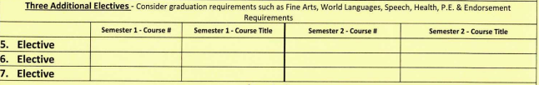
Course Selection Form- Electives
Select three additional courses. Please consider your graduation requirements such as Fine Arts, Language, PE, & Speech/Health, as well as the first course required in your endorsement pathway. If the course is only one semester, please ensure you select another course for second semester.
CHS010
Prin. Health Sci
CHS010
Prin. Health Sci
FL112
Spanish 1
FL112
Spanish 1
PH0111
Health
CAT380
Speech
Notes:
Where will course selection sheet be for students to be able to find the course numbers?

Slide 15

Course Selection Form- Alternatives
PE311
PE
FA013
Art 1
CBU010
Prin. of Business, Marketing, Fin.
In order of preference, list at least three alternative courses. Alternatives are highly suggested in World Languages, Fine Arts, and your Endorsement Pathway.
IF YOU DO NOT SELECT ALTERNATES, YOUR COUNSELOR WILL SELECT FOR YOU BASED ON COURSE AVAILABILITY AND YOUR GRADUATION REQUIREMENTS.

Slide 16
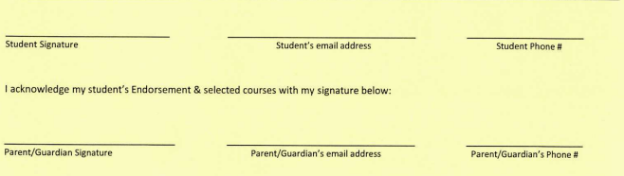
Course Selection Form- Signatures
Please make sure you sign your Course Selection Sheet and get your parent to sign. Course Selection Sheets will not be accepted without a parent signature.
Sally Smith
Sally.S1@student.fortbendisd.com
281-327-0116
Susan Smith
Sallymom@gmail.com
281-327-0116

Slide 17
Sample 9th Grade Schedule
1. English 1
2. Algebra AAC
3. Biology AAC
4. World Geography
5. Principles of Health Science
6. Spanish 1
7. PE

Slide 18


James Reese Career and Technical Center
If you plan to apply for a Reese Center course, DO NOT add this on your course selection sheet or in SchoolLinks. Please add courses that you will take if you do not get accepted. Counselors will add Reese courses to your schedule when we are provided the students that have been accepted.

Slide 19
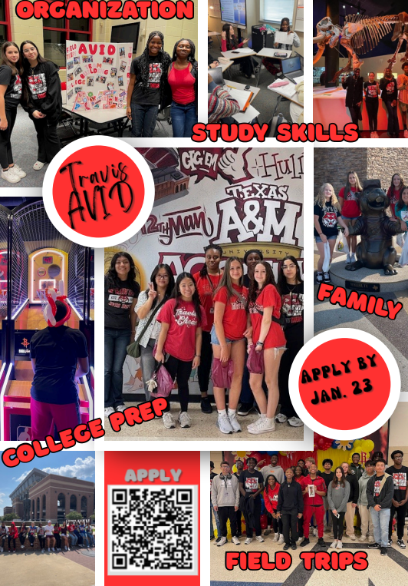
AVID-Advancement Via Individual Determination

Slide 20
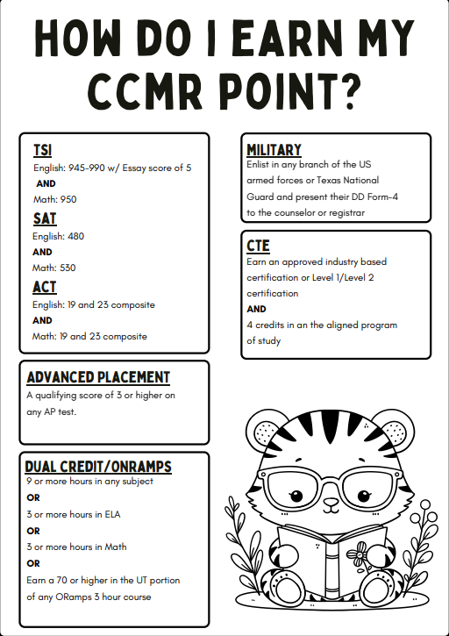
CCMR- College, Career, and Military Readiness
Fort Bend ISD aims for at least 90% of senior students to achieve college, career, and/or military readiness as they prepare for their unique futures.

Slide 21

Course Selection- School Links
Students will input course selections in School Links for the 2026-2027 school year.
Instructions on how to complete course selection in School Links will be sent to students and parents.

Slide 22
Questions?

